Slide 1
A FUZZY RULE BASED DECISION MAKING ALGORITHM FOR DETECTION OF FLOOD EVENT
Guided by
Dr.N.Uma maheswari.
professor(CSE).
Presented By
Name : E.Mehuva.
Reg no: 921315405010.

Slide 2
Introduction
Floods are among the most destructive natural disasters worldwide. In flood disaster management programs, flood mapping is an initial step.
The class of the water bodies was extracted from the Landsat image and then subtracted from that extracted from the TerraSAR-X image.
The remaining water bodies represented the flooded locations.

Slide 3
Introduction (contd…)
Object-oriented classification and Taguchi method were implemented for both images.
The Landsat images were categorized into three classes, namely, urban, vegetation, and water bodies.
Then only water bodies were extracted from the TerraSAR-X image.
To obtain the multiple parameters from image segmentation process, fuzzy set theory is proposed.
The multiple parameter helps to improve the segmentation accuracy and reduces the uncertainty for determining a weight of each response.

Slide 4
Abstract
Floods are among the most destructive natural disasters worldwide.
Floods can be managed efficiently through flood susceptibility, hazard, and risk mapping which is based on the identification of flooded areas.
This work provides an efficient algorithm to make decision in detection of flood.
This algorithm makes separation between water bodies and flood locations in Synthetic Aperture Radar (SAR) imagery.
This system incorporates the classification technique for the characterization of building roofs, paddy fields, and water bodies.

Slide 5
Objective
To obtain the multiple parameters from image segmentation process, fuzzy set theory is proposed.
The multiple parameter helps to improve the segmentation accuracy and reduces the uncertainty for determining a weight of each response.

Slide 6
Existing System
Flood detection analysis used to analyze the flood locations and map all the locations.
Visual interpretation method is used to detect flood locations and increased the accuracy.
Optical images are used in detection of flood locations.
Threshold segmentation algorithm or histogram thresholding is used to generate the binary image to detect the flood detection.
Single frequency and single polarization is used to map the flood locations and it limits the noise.
Taguchi method in segmentation is used to discriminate the water bodies and flood locations.

Slide 7
Disadvantages
Flood detection analysis is time consuming and costly.
The visual interpretation of satellite images is a time-consuming, inaccurate and costly method.
Optical sensors may be affected by atmospheric conditions.
Thresholding techniques is sensitive to low contrast images.
Single frequency and single polarization is inaccurate and far from the object boundary.
Taguchi method only deals with a three parameter in the existing work.

Slide 8
Proposed System
In proposed system, Image segmentation is performed by using fuzzy set theory to obtain multiple parameter.
This procedure can reduce the uncertainty for determining a weight of each response and it is a universal approach which can simultaneously deal with continuous and discrete parameter.
Multiple parameter decision making (MPDM) involves the selection among some alternatives each having multiple, usually conflicting, parameters.
This multiple parameter decision making improves the segmentation accuracy.

Slide 9
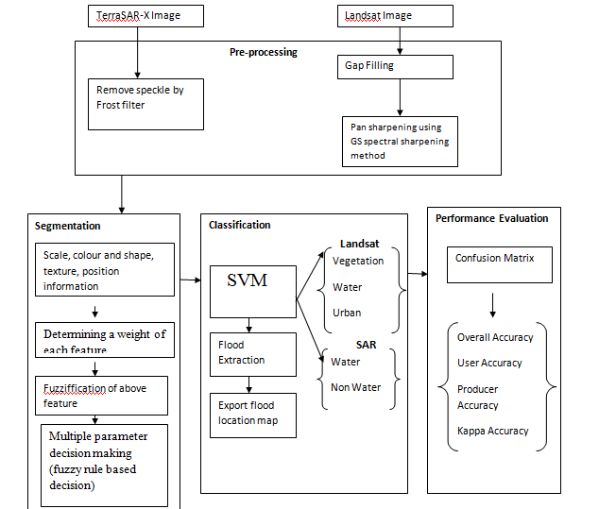
ARCHITECTURE DIAGRAM

Slide 10
Modules list
Module:1 Image preprocessing
Module:2 Segmentation based on Taguchi optimization algorithm
Module:3 Segmentation based on fuzzy rule based decision
Module:4 Classification
Module:5 Performance comparison

Slide 11
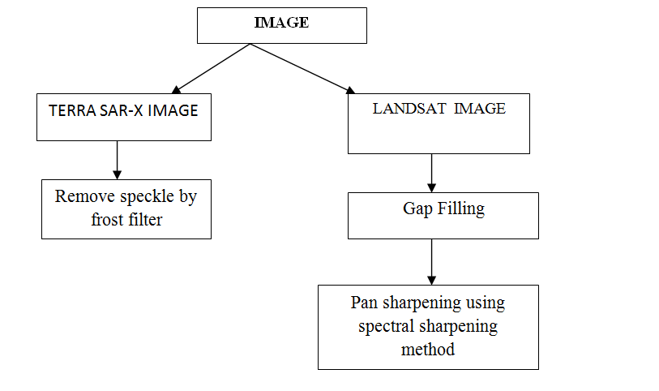
Module:1 Image preprocessing

Slide 12
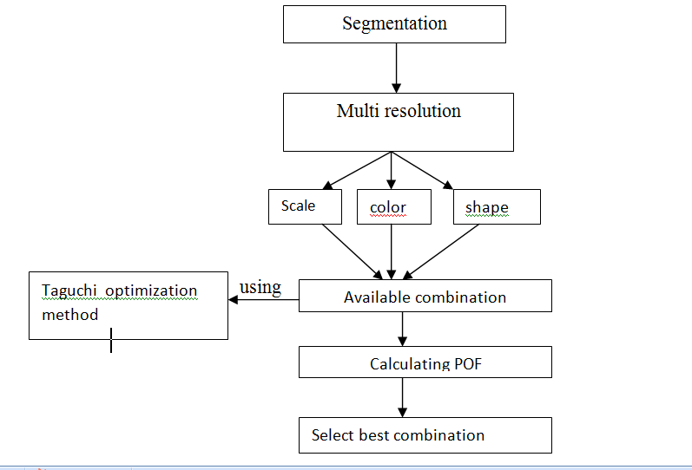
Module:2 Segmentation based on Taguchi optimization algorithm

Slide 13
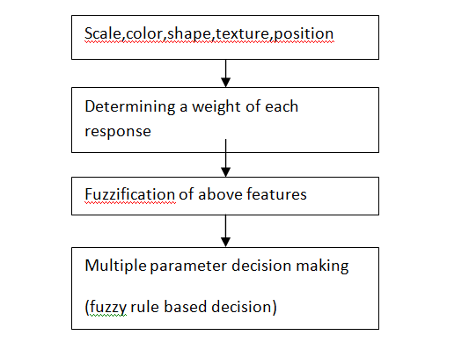
Module:3 Segmentation based on fuzzy rule based decision

Slide 14
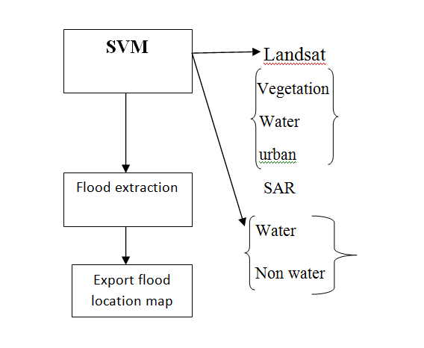
Module:4 Classification

Slide 15
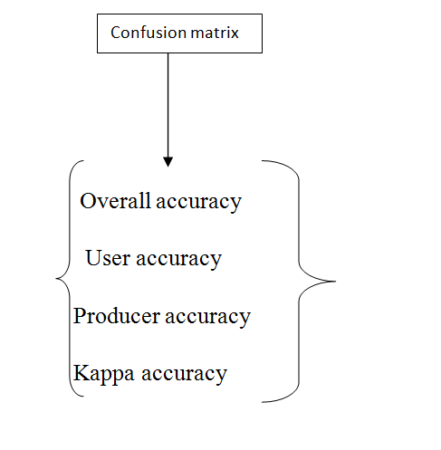
Module:5 Performance comparison

Slide 16
Hardware/Software required
HARDWARE
Processor : Intel Pentium IV processor, 32 bit
Hard Disk Drive : 80GB Hard Disk drive
RAM : 2 GB of RAM
Cache Memory : 256KB Full Speed
Monitor : 17” Color Monitor
Keyboard : 110 keys Standard Keyboard
Mouse : Optical Mouse
SOFTWARE
Operating System : Windows XP and above
Language Tool : MATLAB R2014a

Slide 17
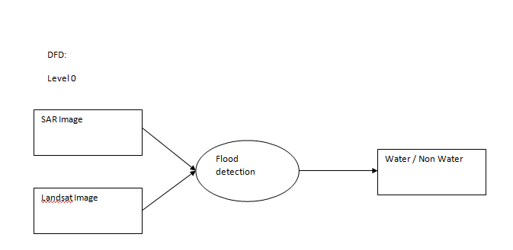

Slide 18
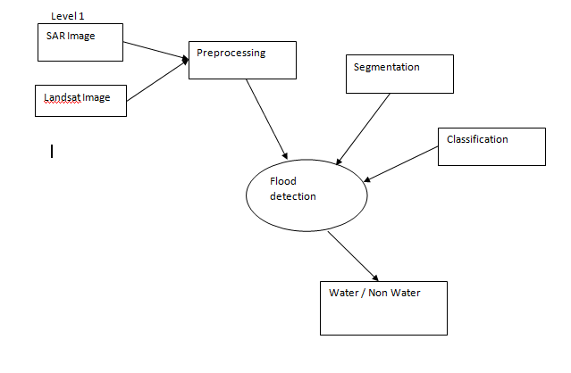

Slide 19
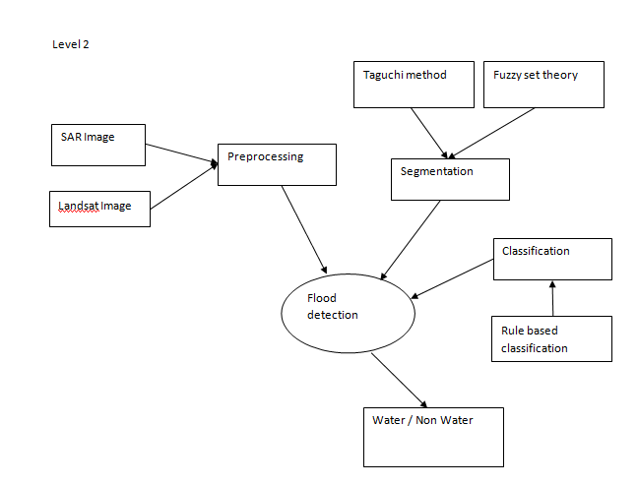

Slide 20
Algorithms Used
Taguchi technique for segmentation
SVM classification algorithm
fuzzy set theory

Slide 21
Fuzzy Set theory
Shape, color, scale, texture and position parameters are extracted
Apply fuzzification for the parameters
Multiple parameter decision making is achieved by fuzzy rule based decision

Slide 22
Expected outcomes
Recognize and map flooded areas.
Improving Overall accuracy.

Slide 23
Literature Survey
S. No. | Title | Author | Methods | Merits | Demerits
1. | Self-Supervised Segmentation of River Scenes | Supreeth Achar, Bharath Sankaran, Stephen Nuske, Sebastian Scherer and Sanjiv Singh. | Self-supervised method, Feature extraction | Increase robustness | Horizon regions are not detected
2. | A comparative assessment between object and pixel-based classification approaches for land-use/land-cover mapping using SPOT 5 imagery | Mahyat Shafapour Tehrany, Biswajeet Pradhan, Mustafa Neamah Jebuv | DT classifier, SVM, K-NN classifiers | Increased classification accuracy | It requires very high resolution data

Slide 24
Literature Survey
S.No. | Title | Author | Methods | Merits | Demerits
3. | Flood monitoring using multi-temporal COSMO SkyMed data: Image segmentation and signature interpretation | L. Pulvirenti, M. Chini, N. Pierdicca, L. Guerriero, P. Ferrazzoli | Automatic image segmentation technique | Increases classification accuracy | More case studies are required
4. | SAR polarimetric change detection for flooded vegetation | B. Brisco, A. Schmitt, K. Murnaghan, S. Kaya and A. Roth | Curvelet-based approach, Polarimetric decomposition | Improved detection | Limited parameters

Slide 25
Literature Survey
S. No. | Title | Author | Methods | Merits | Demerits
5. | A New Semiautomated Detection Mapping of Flood Extent From TerraSAR-X Satellite Image Using Rule-Based Classification and Taguchi Optimization Techniques | Biswajeet Pradhan, Mahyat Shafapour Tehrany, and Mustafa Neamah Jebur | Taguchi method, object-oriented rule based classification | Increased accuracy | Limited parameters and spatial resolution differences makes misclassification

Slide 26
References
J. M. Martinez and T. Le Toan, “Mapping of flood dynamics and spatial distribution of vegetation in the Amazon floodplain using multitemporal SAR data,” Remote Sens. Environ., vol. 108, no. 3, pp. 209–223, 2007.
A.M. Youssef, B. Pradhan, and A.M. Hassan, “Flash flood risk estimation along the St. Katherine road, southern Sinai, Egypt using GIS based morphometry and satellite imagery,” Environ. Earth. Sci., vol. 62, no. 3, pp. 611–623, 2011.
M. S. Tehrany, B. Pradhan, andM. N. Jebur, “Spatial prediction of flood susceptible areas using rule based decision tree (DT) and a novel ensemble bivariate and multivariate statistical models in GIS,” J. Hydrol., vol. 504, no. 4, pp. 69–79, 2013.

Slide 27
References(contd…,)
M. S. Tehrany, B. Pradhan, and M. N. Jebur, “Flood susceptibility mapping using a novel ensemble weights-of-evidence and support vector machine models in GIS,” J. Hydrol., vol. 512, no. 2, pp. 332–343, 2014.
F. Ip et al., “Flood detection and monitoring with the Autonomous Sciencecraft Experiment onboard EO-1,” Remote Sens. Environ., vol. 101, no. 4, pp. 463–481, 2006.
B. Pradhan, U. Hagemann, M. Shafapour Tehrany, and N. Prechtel, “An easy to use ArcMap based texture analysis program for extraction of flooded areas from TerraSAR-X satellite image,” Comput. Geosci., vol. 63, no. 2, pp. 34–43, 2014.

Slide 28
Pradhan, B., Tehrany, M. S., & Jebur, M. N. (2016). A New Semiautomated Detection Mapping of Flood Extent From TerraSAR-X Satellite Image Using Rule-Based Classification and Taguchi Optimization Techniques. IEEE Transactions on Geoscience and Remote Sensing, 54(7), 4331-4342.

